Slide 1
COVID-19
Economic Relief Package
NJEDA initiatives aimed at stabilizing and revitalizing local small businesses, mid-size businesses, and other
early-stage companies
March 31, 2020

Slide 2
We have developed our economic stability approach around three core principles
Get funding into the market as soon as possible
  Where possible, adjust existing NJEDA programs to address crisis needs
  Utilize multiple channels / partners to maximize marketing of programs and minimize processing capacity constraints
Leverage private, federal, and philanthropic capital where possible to scale impact
Provide a suite of compatible offerings to help address varied marketplace needs (e.g., grants, no-cost loans, low-cost loans, loans through intermediaries, technical assistance)

Slide 3





COVID-19 Economic Relief Package
SMALL BUSINESS EMERGENCY ASSISTANCE GRANT PROGRAM
SMALL BUSINESS EMERGENCY ASSISTANCE LOAN PROGRAM
PROGRAMS TO MOBILIZE CAPITAL TO MICRO-, SMALL, & MEDIUM-SIZED BUSINESSES
CDFI First Loss Reserve Fund
Emergency Assistance Guarantee
Entrepreneur Support Program
NJ TECHNICAL ASSISTANCE SUPPORT
CREDIT FLEXIBILITY TO SUPPORT BUSINESSES

Slide 4
SMALL BUSINESS EMERGENCY ASSISTANCE GRANT PROGRAM
Operating expense grants of up to $5K
to small businesses with 1-10 FTE
in highly impacted industries
NJEDA Program Size
$5M (initial wave)
Business Eligibility
Industries, as determined by NAICS code:
  Retail
  Accommodation & Food Service
  Arts, Entertainment, & Recreation, Repair & Maintenance; Personal & Laundry Services
  (Eligible NAICS codes that start with
  44, 45, 71, 72, 811, 812)
Non-profit entities in the above industries are permitted to receive grant funding if they also have the following designations: 501(c)(3), 501(c)(4), and 501(c)(7)
Must certify to negative impact of emergency
Physical commercial location in NJ
Must be registered to do business in New Jersey
Department of Labor good standing
1-10 FTE per Company’s 2019 4th Quarter NJ-WR30 filing with the Department of Labor: visit https://forms.business.nj.gov/grant-size/ to estimate your FTE
Must fill out and certify simplified debarment legal questionnaire

Slide 5
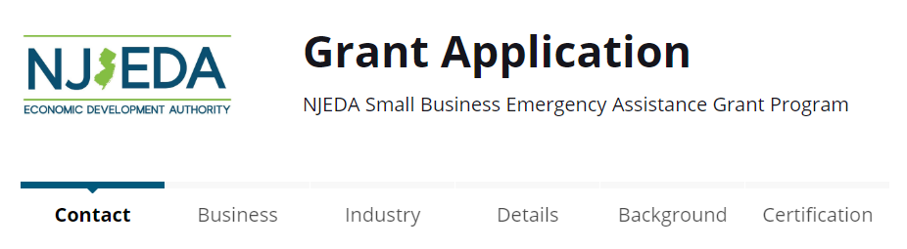
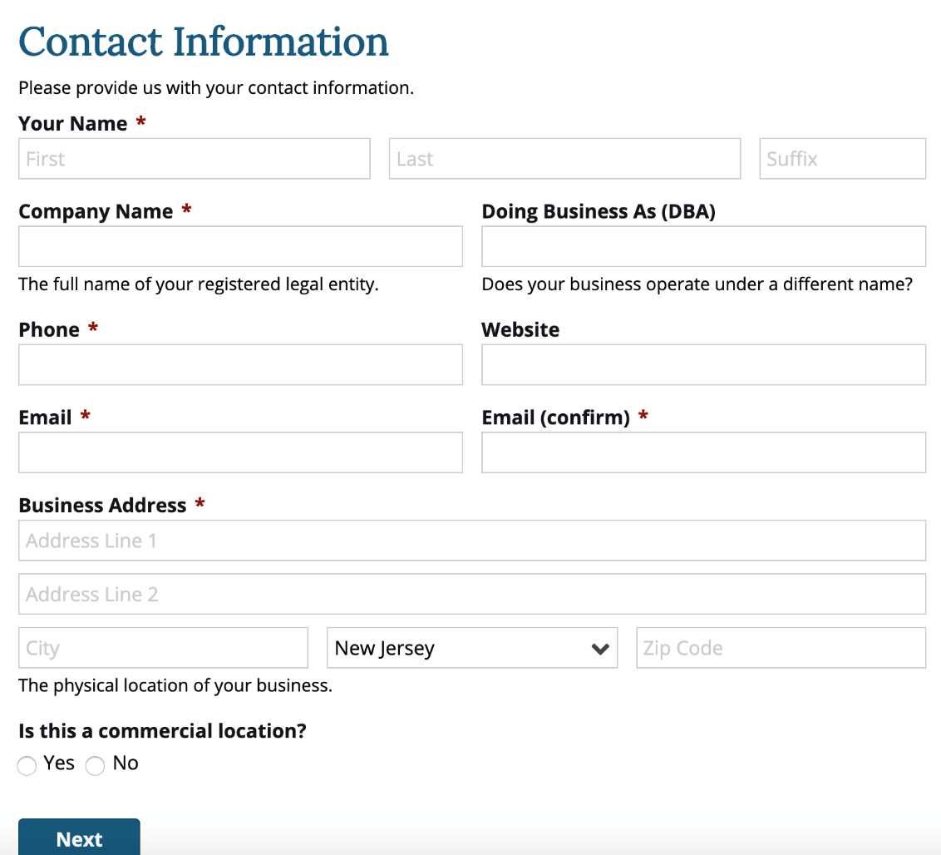
Grant Application Screen Shots: Contact information
Application window opens on:
Friday, April 3rd 9:00am ET
Application window closes on:
Friday, April 10th 9:00am ET
Application will be available at:
https://cv.business.nj.gov

Slide 6
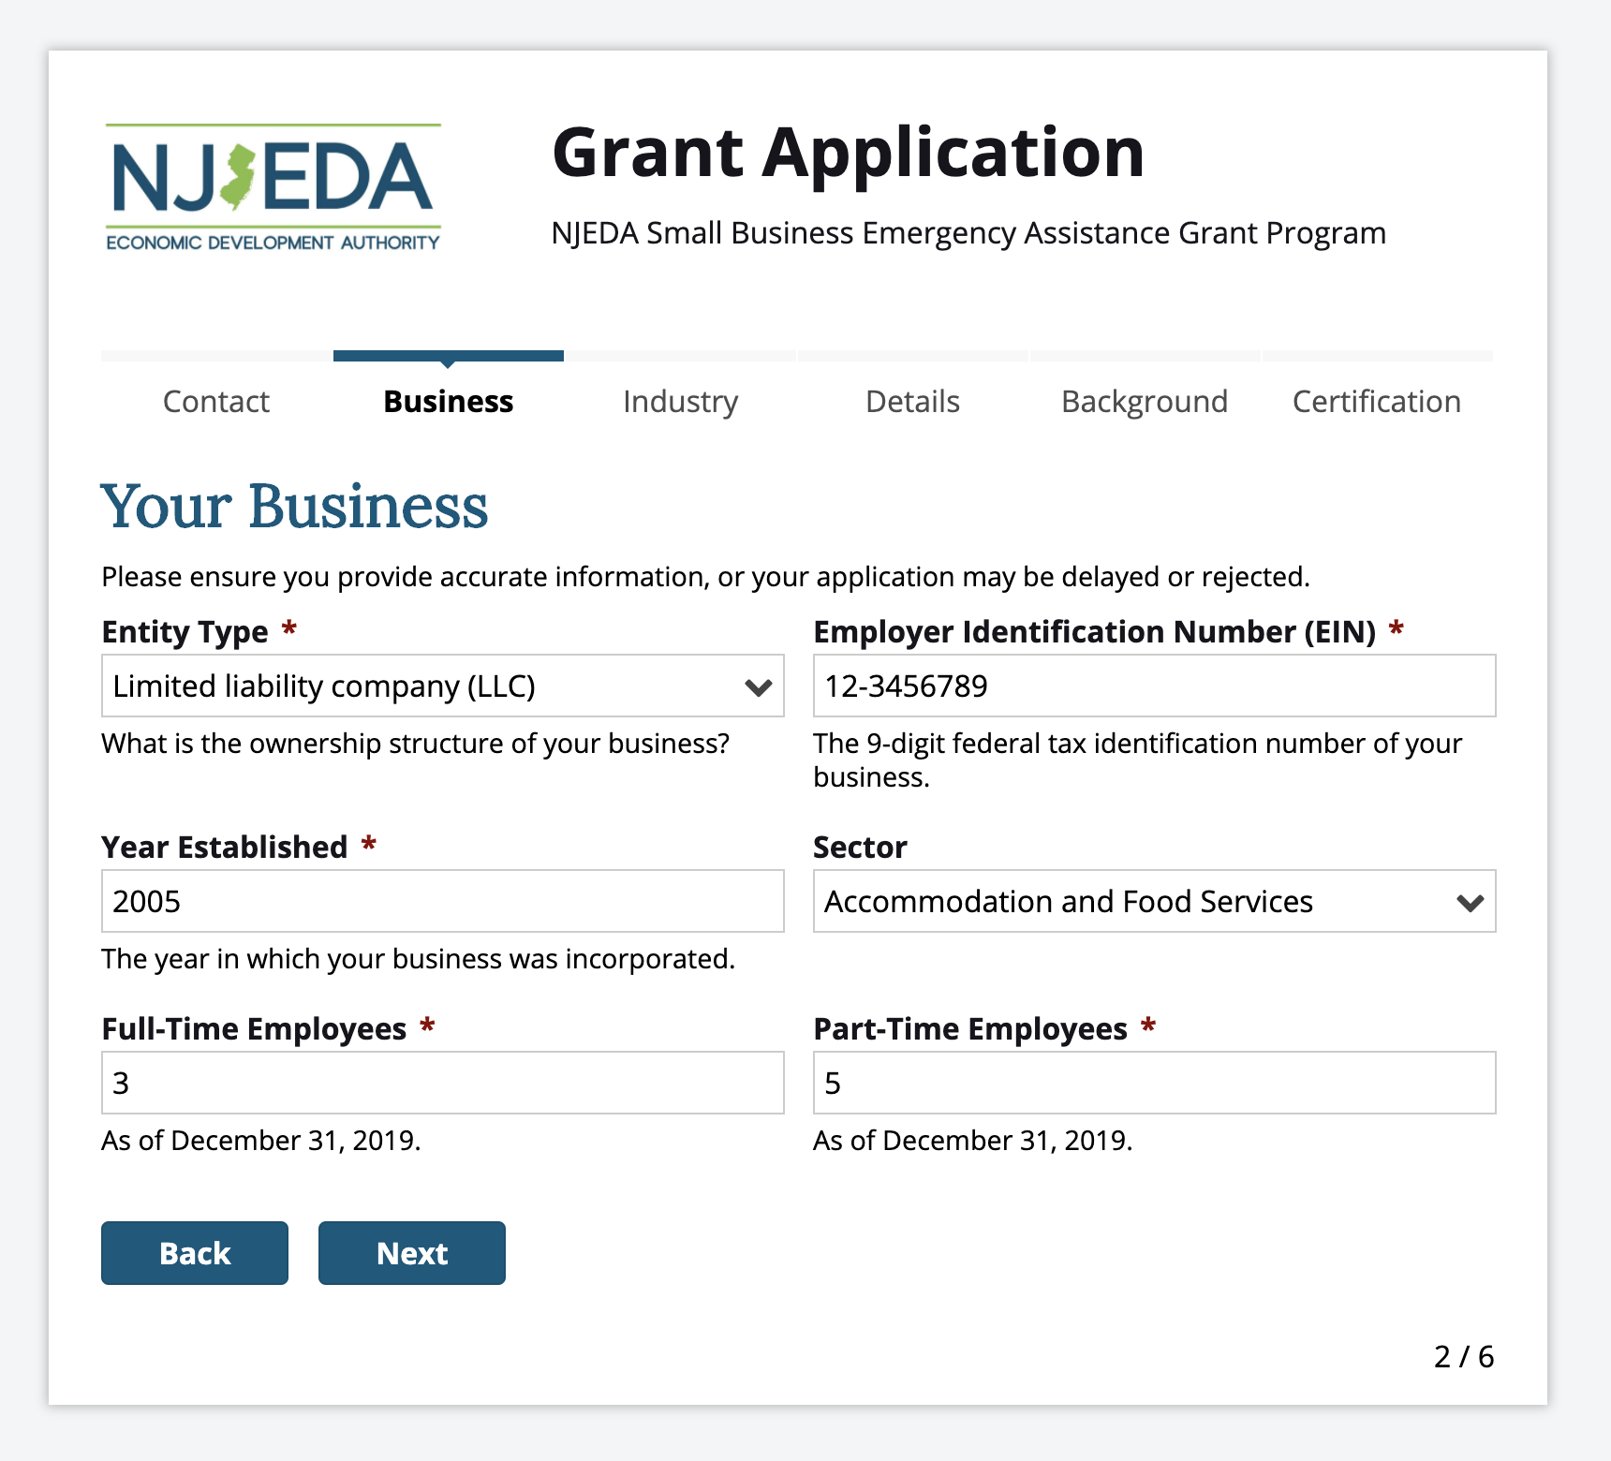
Grant Application Screen Shots: Information about your business

Slide 7
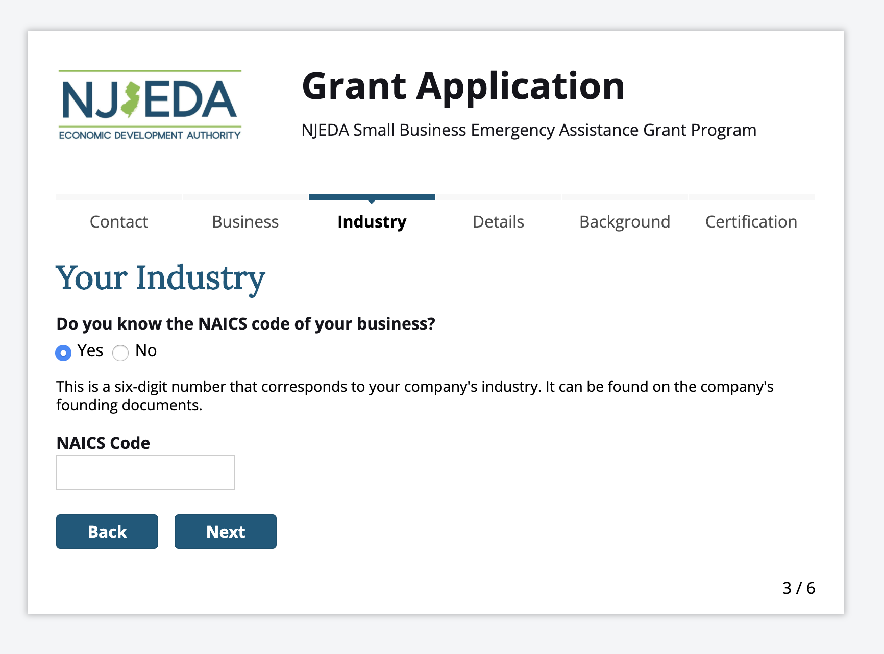
Grant Application Screen Shots: Information about your industry (1/2)

Slide 8
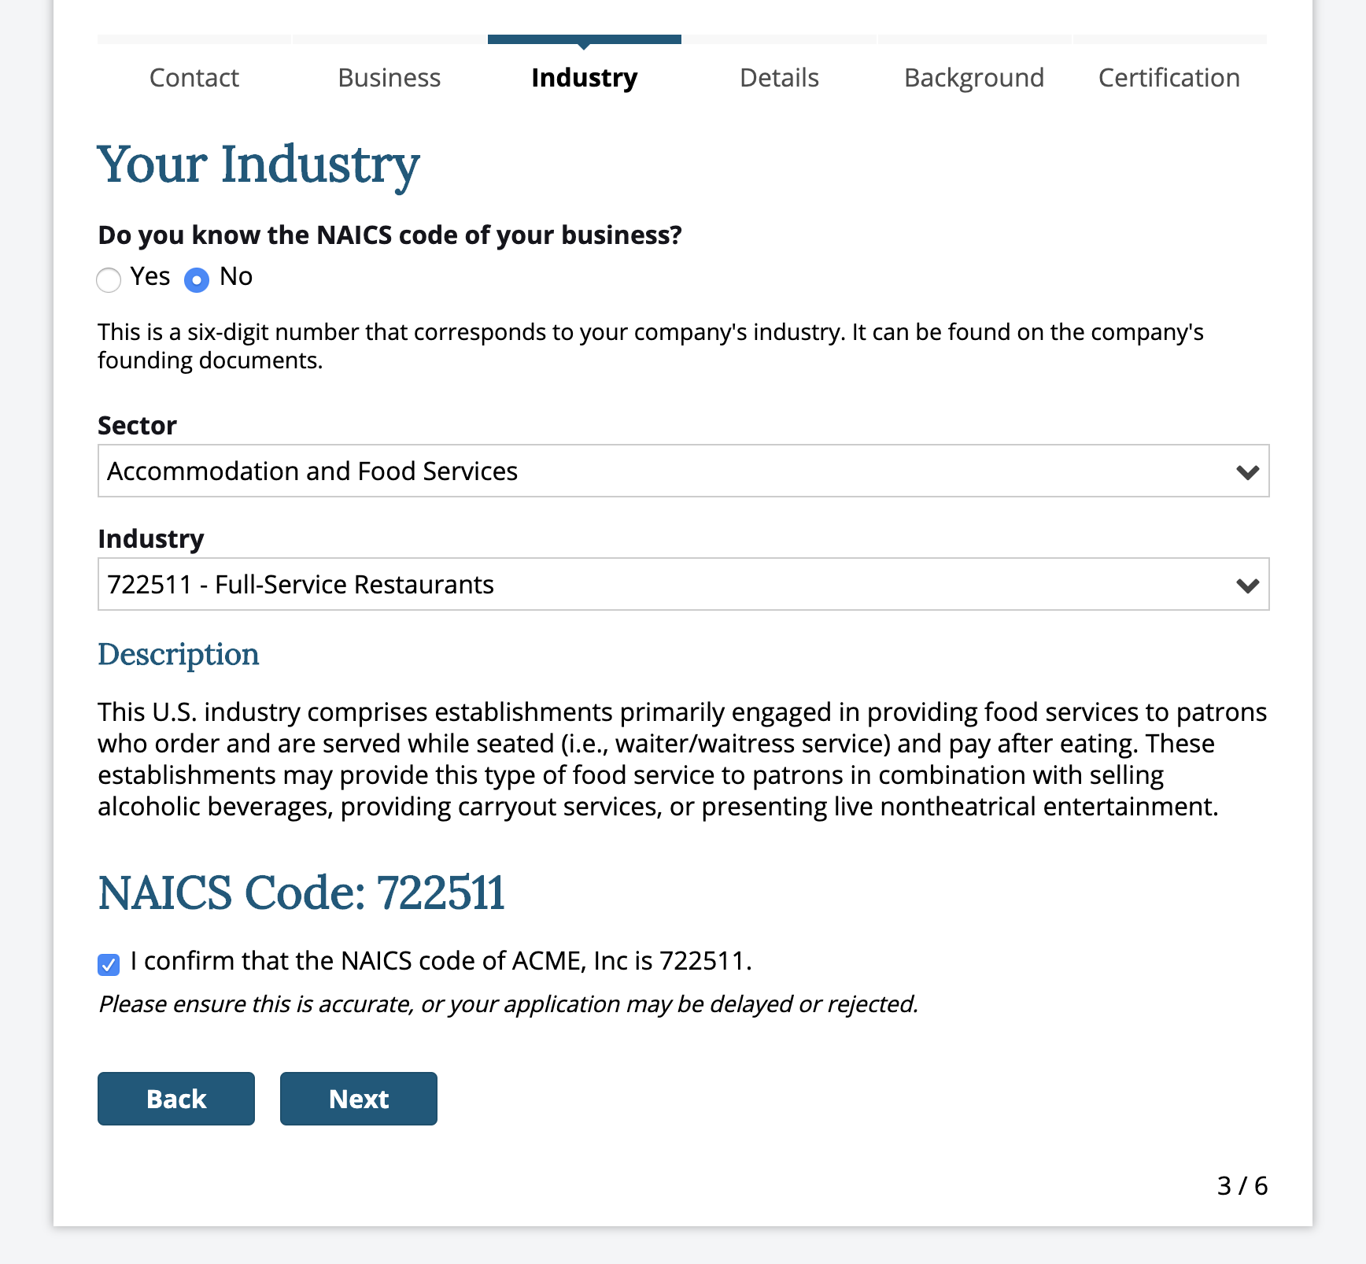
Grant Application Screen Shots: Information about your industry (2/2)

Slide 9
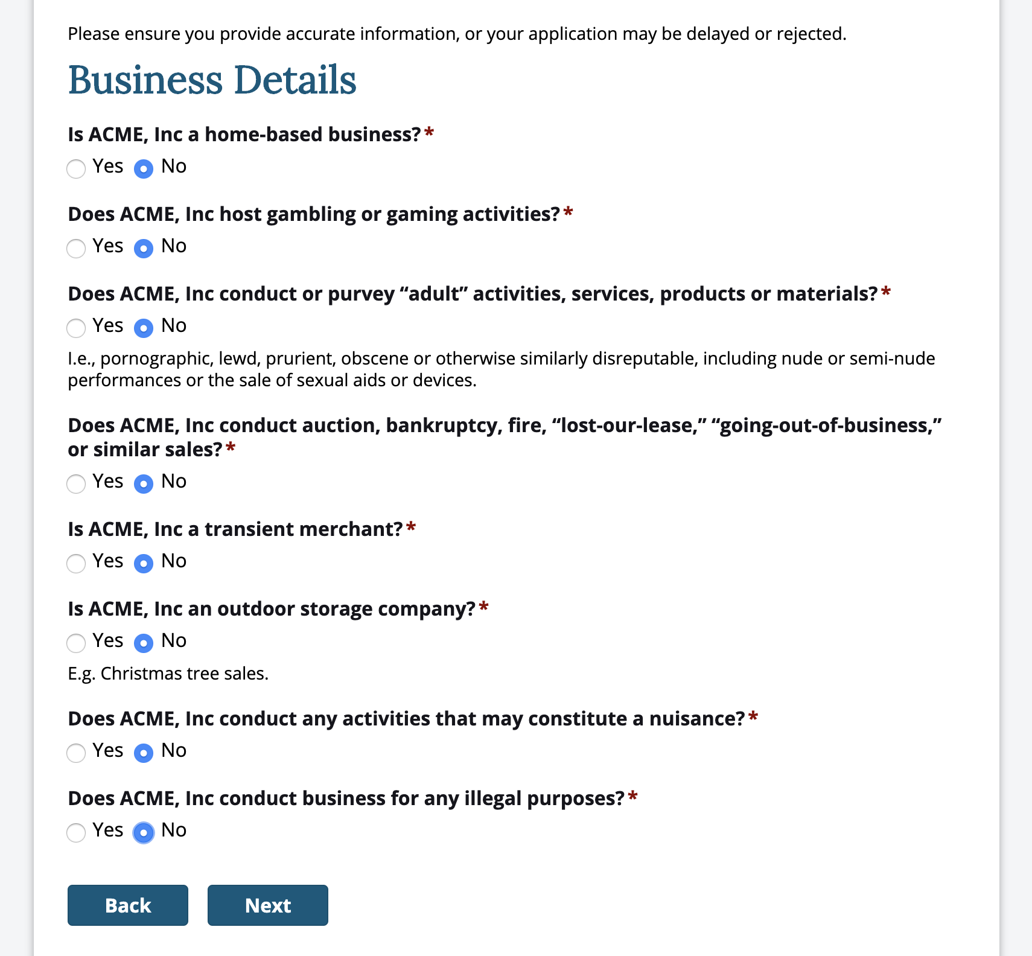
Grant Application Screen Shots: Business Details

Slide 10
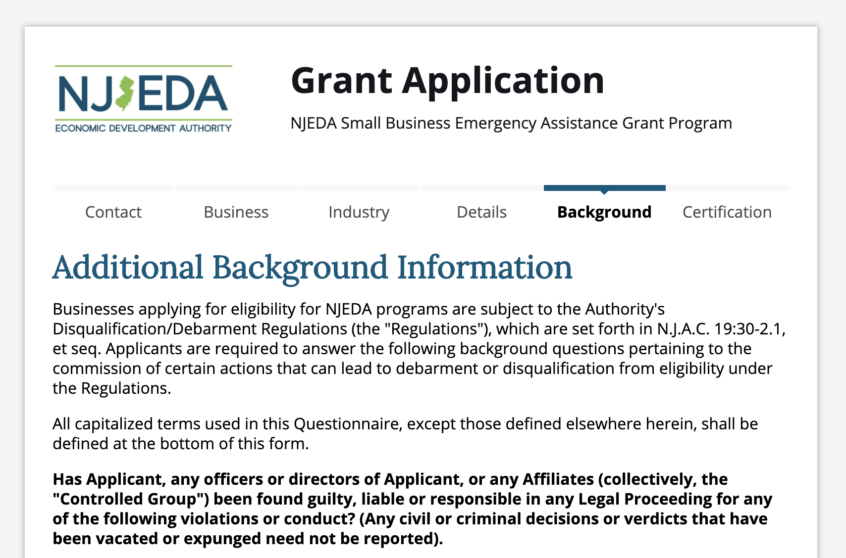
Grant Application Screen Shots: Additional Background and Certifications (1/2)

Slide 11
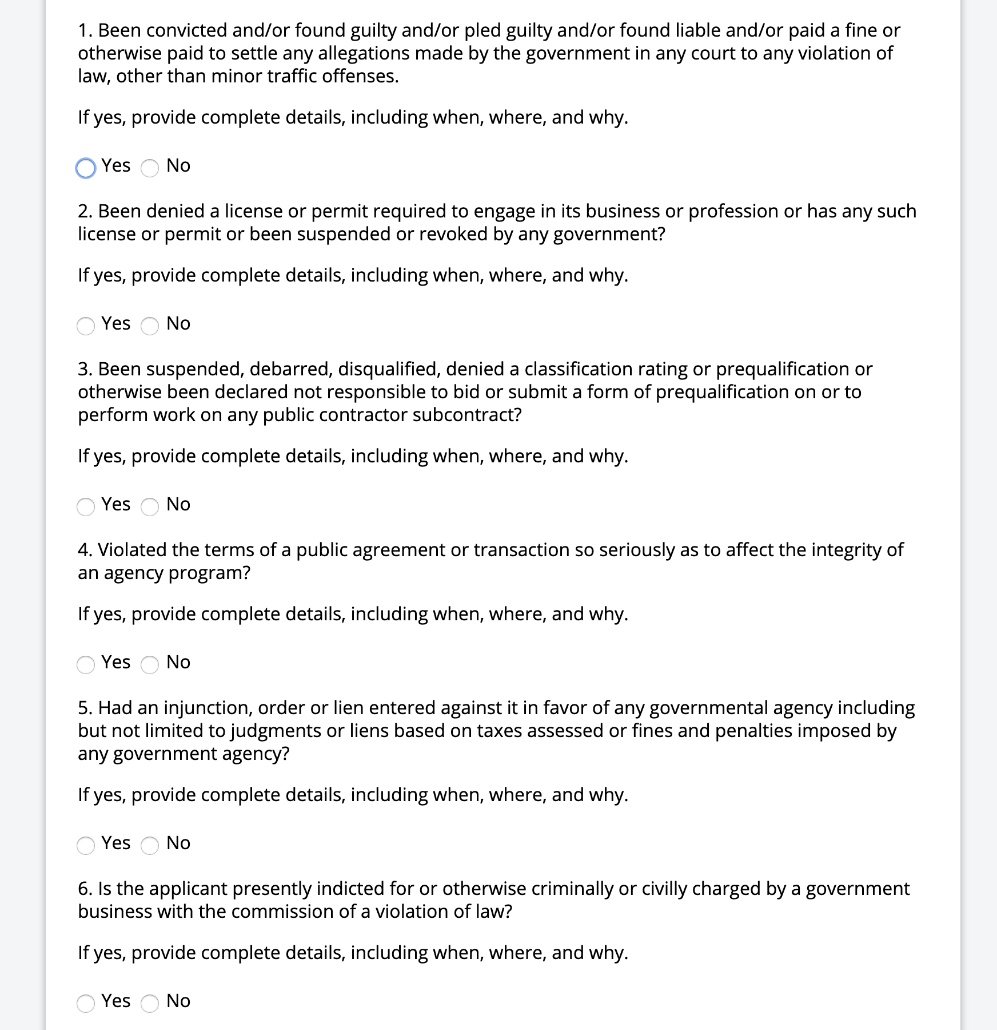
Grant Application Screen Shots: Additional Background Information
Question about prior convictions
Questions about license or permit denials or revocations
Question about public debarment
Question about breaking the terms of an agreement with a public agency
Question about any injunction orders in favor of a government agency
Question about ongoing criminal or civil proceedings

Slide 12
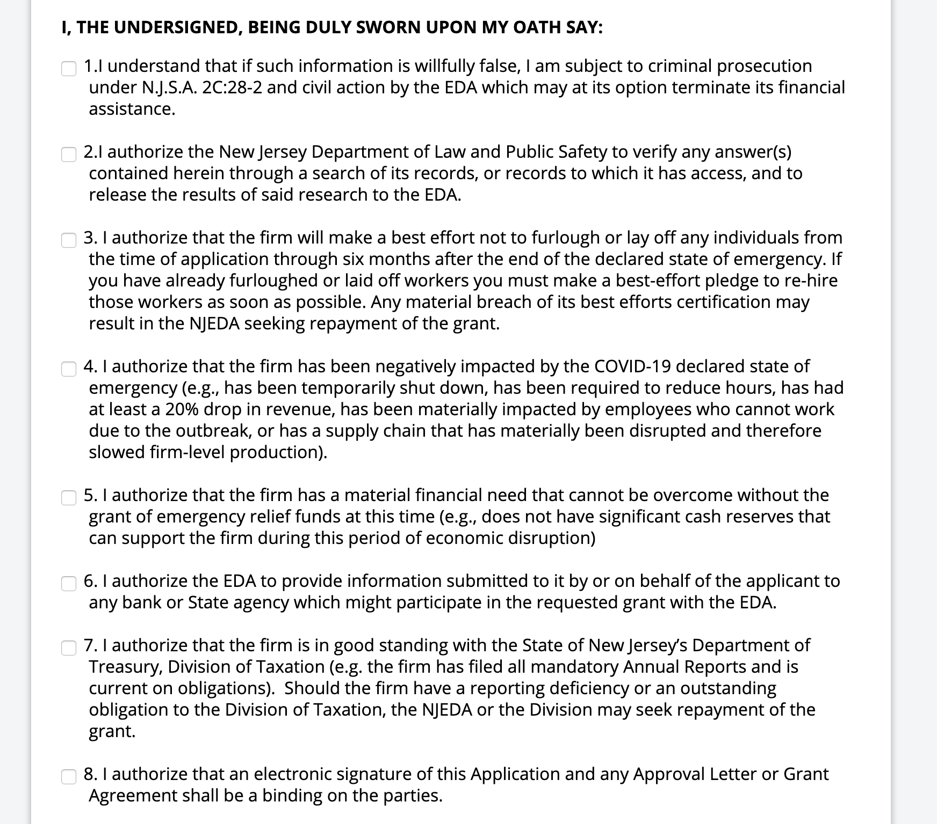
Grant Application Screen Shots: Certifications (1/2)
False statements can be prosecuted
Dept. of Law can verify my answers
Best effort not to lay off employees and rehire those that have already been let go
I have been negative impacted by COVID-19
This grant is needed by my business
NJEDA can share information with specific parties to execute this grant
I am in good standing with the Departments of Labor and Taxation
I am signing this electronically

Slide 13
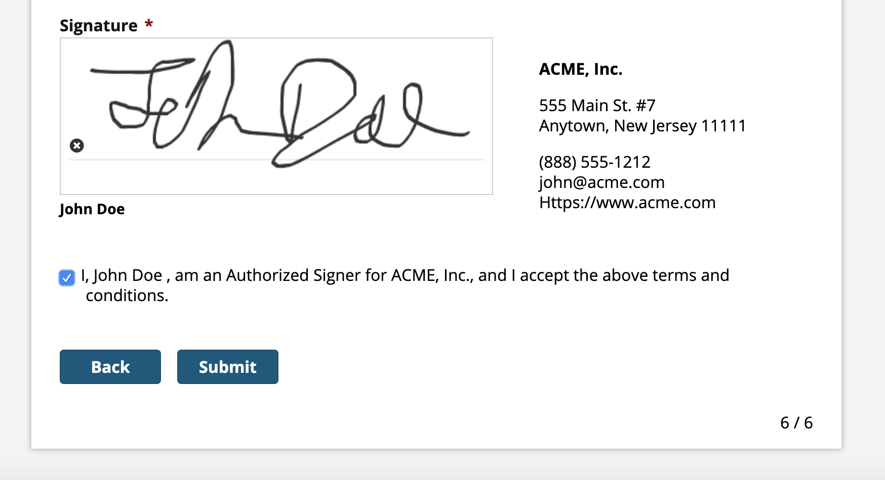
Grant Application Screen Shots: Certifications (2/2)

Slide 14
Grant Application Screen Shots: Confirmation

Slide 15
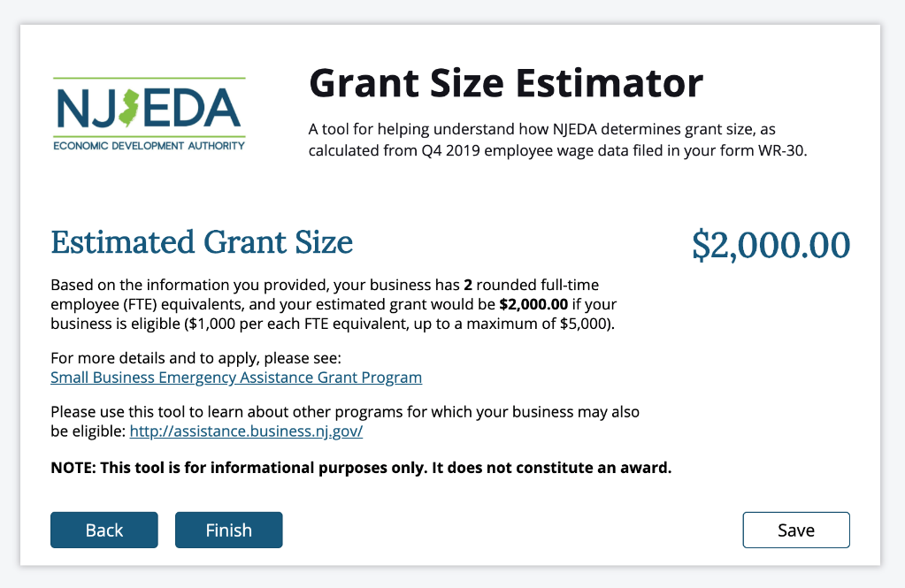
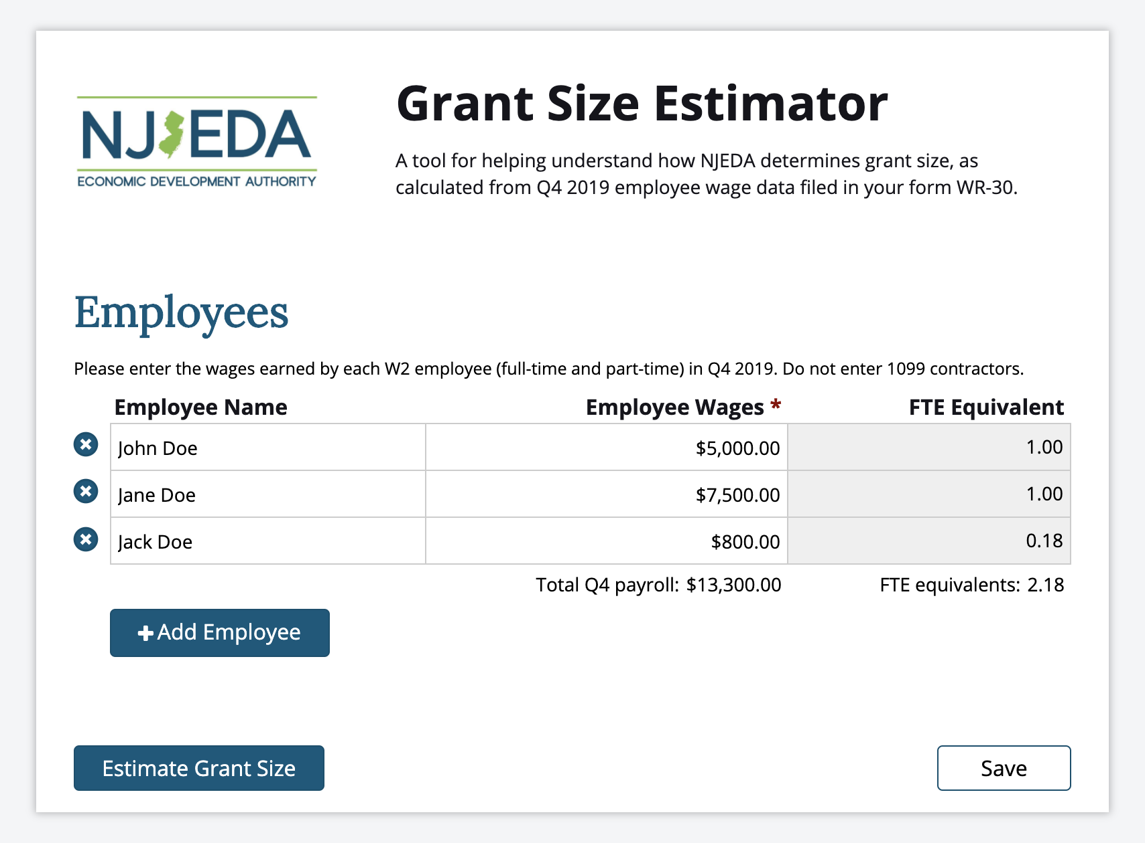
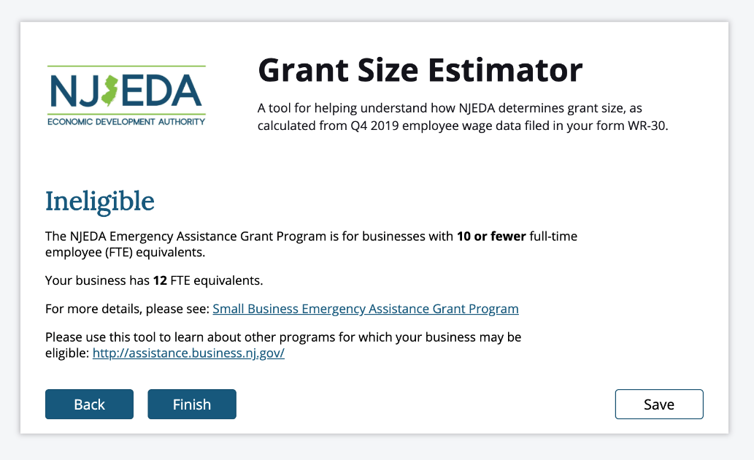
Grant Award Size Estimate Calculator Screen Shot
Available at: https://cv.business.nj.gov

Slide 16
SMALL BUSINESS EMERGENCY ASSISTANCE LOAN PROGRAM
Up to $100K working capital loans for
up to 10 years for businesses with $5 million or less in revenue; 0% for years
1-5; 1-3% for years 6-10.
NJEDA Program Size
$10M (initial wave)
Business Eligibility
$5M or less annual revenue
Physical commercial location in New Jersey
At least 1 year in existence
Must be registered to do business in New Jersey
Minimum Global Debt service ratio of 1.0 based on the year prior to the declaration of emergency
Tax Clearance; Department of Labor good standing
Minimum Credit Score of 600 for at least one guarantor
Must show negative impact of emergency (e.g., closure, reduced hours, 20% revenue drop,
20%, etc.)
Additional conditions may apply
Must fill out and certify simplified debarment legal questionnaire

Slide 17
PROGRAMS TO MOBILIZE CAPITAL TO MICRO-, SMALL, & MEDIUM-SIZED BUSINESSES
CDFI First Loss Reserve Fund
$10M capital reserve fund for first-loss position, up to 50%, on CDFI loans that provide low/no-interest loans to micro and small businesses
NJEDA Program Size
$10M (initial wave)
Eligibility
Federally-certified, NJ-based CDFI
Have the operational and financial capacity
to use the guarantee effectively
Have significant experience working with underserved business segments and in communities underserved by other banks
Must fill out and certify simplified debarment legal questionnaire
CDFI Loans that are guaranteed must:
  Be to an impacted business
  Be focused on working capital
  Not exceed $75,000
  Have an interest rate of 3.75% or less
  Not exceed a term of five years
  Provide flexible loan structures

Slide 18
PROGRAMS TO MOBILIZE CAPITAL TO MICRO-, SMALL, & MEDIUM-SIZED BUSINESSES
Emergency Assistance Guarantee
$100,000 Maximum guarantee, 50% guarantee of working capital loans, take first loss position; no fees
NJEDA Program Size
$10M (initial wave)
Business Eligibility
Must work through a Premier Lender bank
or Premier CDFI
$5M or less in revenue
Physical commercial location in NJ
At least 1 year in existence
All industries eligible
Must show negative impact of emergency (e.g., closure, reduced hours, 20% revenue drop, supply chain disruption, etc.)
Must fill out and certify simplified debarment legal questionnaire
Tax Clearance; Department of Labor good standing
Non-profits are eligible

Slide 19
PROGRAMS TO MOBILIZE CAPITAL TO MICRO-, SMALL, & MEDIUM-SIZED BUSINESSES
NJ Entrepreneur Support Program
Provide 80% loan guarantees for working
capital loans to start-up entrepreneurs
NJEDA Program Size
$5M (initial wave)
Eligibility
Must be NJ-based start-up company (registered to do business, C-suite in the State)
Under $5M in revenue; under 25 people
Investors have already provided funding in the form of a convertible note, safe or equity interest.
Investor does not need to be NJ-based
Align with the Governor’s Economic Plan
Must fill out and certify simplified debarment legal questionnaire
Tax Clearance; Department of Labor
good standing
Minimum of 50% of employees in NJ

Slide 20
NJ TECHNICAL ASSISTANCE SUPPORT
Support for organizations providing technical assistance to COVID-19 Impacted Small Businesses Applying for SBA Funding Programs
NJEDA Program Size
$150K (initial wave)
This assistance includes, but is not limited to, preparing financial information, packaging application documentation, and completing and submitting the on-line or paper-based application.
  African American Chamber of Commerce
  of New Jersey (AACCNJ)
  New Jersey State Veterans Chamber of Commerce
  Rising Tide Capital
  Statewide Hispanic Chamber of Commerce
  of New Jersey (SHCCNJ)

Slide 21
CREDIT FLEXIBILITY TO SUPPORT BUSINESSES
Ability to provide flexible terms to portfolio
customers impacted by COVID 19
Expanded delegations to provide quick cash flow relief and to facilitate business access to funding for working capital to continue operations and employment in New Jersey through:
Payment Moratoria
Loan Maturity Extensions
Subordinations
Fee Waivers

Slide 22

Businesses Served
Programs for Micro- Businesses | Programs for Small Businesses | Programs for Medium Businesses
SMALL BUSINESS EMERGENCY ASSISTANCE GRANT PROGRAM | SMALL BUSINESS EMERGENCY ASSISTANCE LOAN PROGRAM | EMERGENCY ASSISTANCE GUARANTEE PROGRAM
CDFI FIRST LOSS RESERVE FUND | EMERGENCY ASSISTANCE GUARANTEE PROGRAM | CREDIT FLEXIBILITY TO SUPPORT BUSINESSES
EMERGENCY ASSISTANCE GUARANTEE PROGRAM | NJ ENTREPRENEUR SUPPORT PROGRAM | SMALL BUSINESS EMERGENCY ASSISTANCE LOAN PROGRAM
NJ ENTREPRENEUR SUPPORT PROGRAM | NJ TECHNICAL ASSISTANCE SUPPORT
NJ TECHNICAL ASSISTANCE SUPPORT | CREDIT FLEXIBILITY TO SUPPORT BUSINESSES
CREDIT FLEXIBILITY TO SUPPORT BUSINESSES
Visit cv.business.nj.gov to see what support programs are available to help stabilize your operations and get back on a pathway to growth.
1-800-JERSEY7

Slide 23

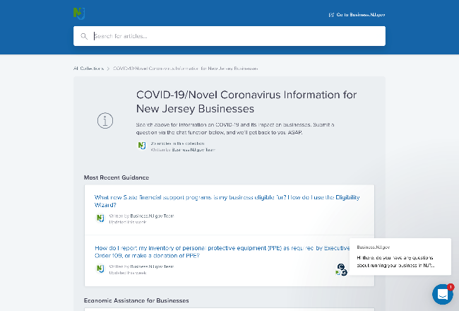
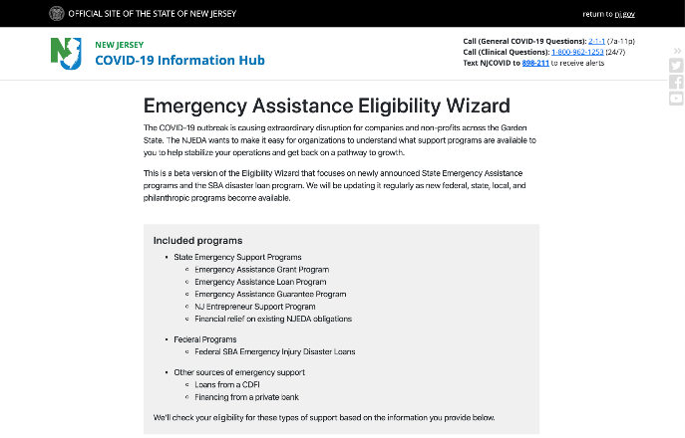
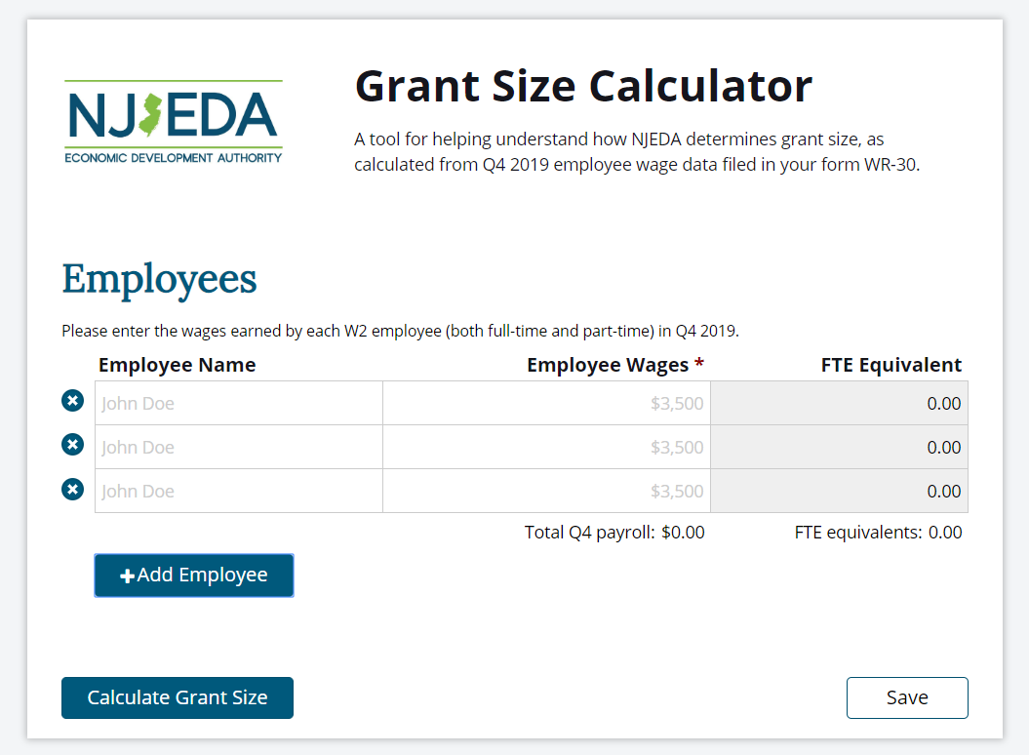
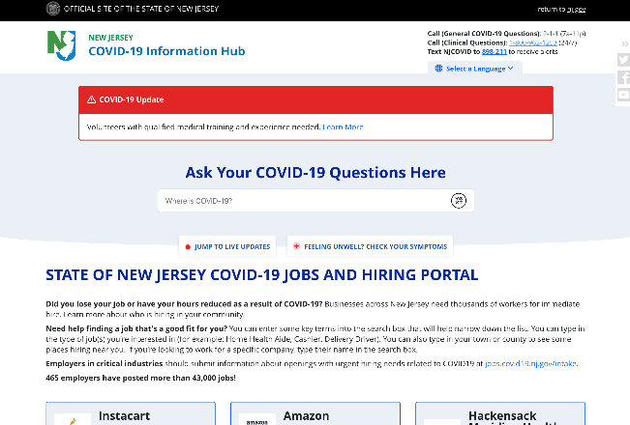
Additional Resources
NEW JERSEY COVID-19 BUSINESS INFORMATION HUB
EMERGENCY ASSISTANCE ELIGIBILITY WIZARD
GRANT AWARD SIZE ESTIMATE CALCULATOR
NEW JERSEY COVID-19
JOBS AND HIRING PORTAL
Get an early estimate of your potential grant award size based on information you submitted on your Q4 2019 NJ WR-30
See what support programs are available to you to help stabilize your operations and get back on a pathway to growth.
Businesses across New Jersey need thousands of workers for immediate hire. Learn more about who is hiring in your community.
Search for information on COVID-19 and its impact on businesses.
CV.BUSINESS.NJ.GOV
CV.BUSINESS.NJ.GOV
CV.BUSINESS.NJ.GOV
JOBS.COVID19.NJ.GOV

